Slide 1

Malvertising and Trusted platform Abuse
Jamila Kaya

Slide 2


JamilA Kaya
@Bumblebreaches
Threat Analyst at Microsoft who has worked in a variety of roles within security for the past 4 years in Identity, Infrastructure, Networking, and Industrial Security.
Specializes in mail, fraud, and threat intelligence
Graduated from Whatcom Community College
Caretaker of two chinchillas

Slide 3

Threat Landscape
10 Minutes

Slide 4
Ransomware and revenue
Crimeware, comprising a multitude of revenue generating and exploit efficient tools increasingly operates close to legitimacy. Ad fraud, extensions, and applications with pseudo legitimate purposes replace trojan horses of the past and monetize legitimately through illegitimate means.
Email accounts, social media identities and browser identity prices depreciate over time
Operating closer to legitimacy and within enterprise spaces allows attackers less scrutiny.
Ad revenue and monetization through plagiarized sites and applications are highly lucrative.
CNBC/Megan Graham: To show how easy it is for plagiarized news sites to get ad revenue, I made my own
Explicitly malicious monetization such as Ransomware and Sextortion are frequently becoming only a portion of attackers overall goals for compromise.

Slide 5
Apps, Ads and ecosystems
Consumer based threats have historically been the like of phishing, adware, greyware, spy and stalkerware, as well as browser and identity based threats that prey on concepts such as implicit consent frameworks and numerous auditing and accountability gaps.
Mobile application stores frequently reward attackers that stay under well known thresholds
Browser extensions, Mobile apps, and browser exploitation in general exploits an existing trust of the container and thus bypasses many security controls ordinarily in place
Massive breaches and user bases prey on implicit consent in these environments and benefit from an over permissive precedent set by legitimate applications.
Ecosystem handlers such as Google, Microsoft and Apple are trusted nearly entirely for the maintenance of these app platforms, providing a false sense of security.

Slide 6
Consumer Deprioritization
Increasing with the move to cloud and SaaS services enterprises and their technology partners alike deprioritize threats seen as mundane, simple or banal. The widening inequity between consumer and enterprise offerings puts pressure on organizations to continue bad security practices.
Security offerings, investigations and response is frequently awarded to enterprise customers.
“Glamorous” security threat focus shifts attention away from more successful tactics that stage and obtain identities in attacks that precede human operated ransomware.
Consumer platforms such as YouTube, Reddit, and Facebook are commonly utilized as C2 infrastructure and hosting sources for malware and commands, evading anomaly detection tools and auditing.
Reporting malicious activity as a single user or researcher is often an uphill battle, with legal risks and little support.

Slide 7
Container collapse
Excessive trust in poorly implemented zero trust environments creates enterprises and end users that rely wholly on containerization and technology vender management of app-stores and software security without proper architecture of across-stack security practices.
“All-in-one” technologies increasingly are quick to overlook numerous pillars of security.
Overemphasis on a secure container such as the browser or mobile application environments ignores risk introduced by legitimate calls and processes that the user can consent to.
Trust in consumer app ecosystems consolidates nearly all risk research onto the ecosystem owners, who may not prioritize security.
When the trust of a browser’s containerization or a phones becomes encompassing, exploits in this space can be considered a part of the growing risk of supply chain attacks.

Slide 8
Lack of incentive and innovation
Technology vendors routinely fail to innovate adequate solutions for what were previously considered low sophistication attacks involving implicit user consent phishing or operating with proximity to legitimacy. Often these same vendors offer no bounties for hunters, no cooperation with smaller organizations who voice concerns, and will often benefit financially from leaving vulnerabilities.
Bug Bounties only recently have begun accounting for application permission abuse, or breach of terms of service or privacy.
Often times malware that abuses known vulnerabilities or relies on the users consent at some point in time are deprioritized for investigation or remediation by bounty adjudicators.
Ad traffic is an absolutely massive revenue generating force and ad providers and buyers benefit from illegitimate traffic. This is true for domain registrars, certificate issuers and other infrastructure components.
Large corporations are making some moves to tighten within-container security controls and improve app store cleanup, but little movement is ongoing in blue team tooling.

Slide 9
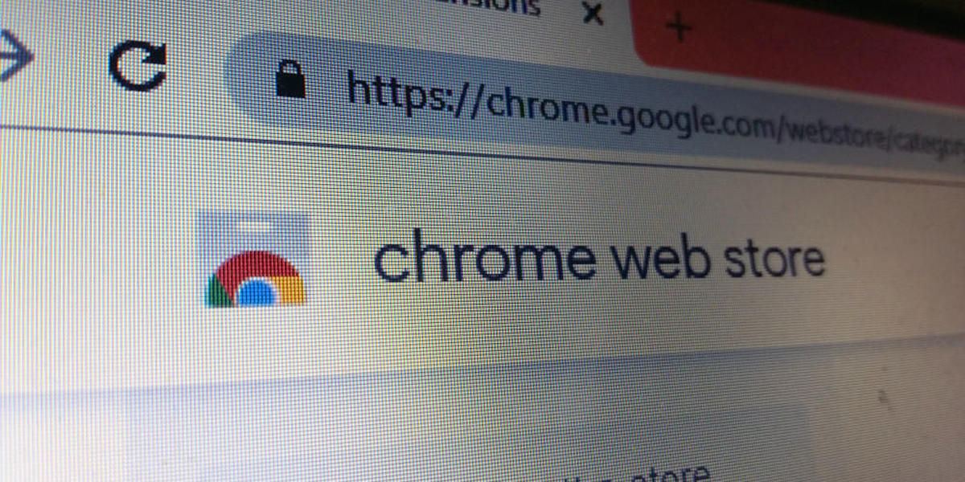
Case Studies
10 Minutes

Slide 10
In the news
Browser extensions and browser security has been at the forefront of recent takedowns and restrictions on app stores for multiple browsers.
500 Copycat Chrome Extensions Removed for Fraud
Dark Reader Clones Exfiltrating Data to C2 Infra
49 Chrome Extensions Stealing Crypto Wallet Keys
CursedChrome Provides Browser Hijack Framework
DataSpii Extensions Siphon Personal Data
David Yomtobian Advertise.com Takedown
3VE Botnet Infects Millions for Ad Fraud

Slide 11
500cE: Initial discovery
Routinely a specific subset of users would show up over time during hunting for ‘unknown” domains in DNS traffic. These users surfaced other network activity patterns that tied together their disparate activity and traced back to Chrome extensions on their devices.
Odd Behaviors
Usual suspects kept reappearing visiting malicious, “unknown” or “fresh” sites
Clustered around numerous past investigations that they all were redirected prior to visit
Off-timed traffic common among users to a DTSINCE.com that seemed related
Redirection sites contained common URI patterns and generated domain names
PCAP provided redirection occurred predictably between malicious sites and advertising
Activity was traced through EDR back to extensions on the hosts that were all distinct
Forensics pulled cleartext commands from the C2 with a full list of redirector domains

Slide 12
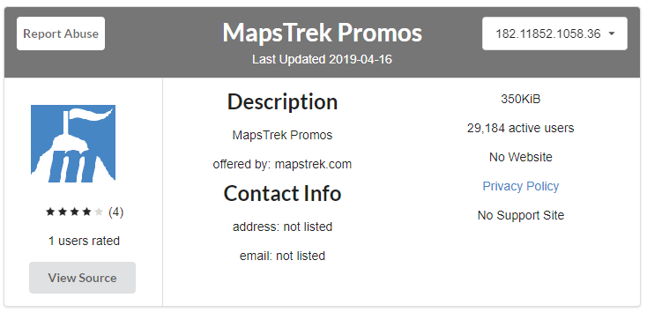
500CE: Iterative hunting
Using CRXCavator.io and other OSINT tools I was able to extrapolate out a larger net of extensions that shared qualities that make them stand out to human intervention but were being missed by fraud detection within the app ecosystem.
Copycat Extensions
Nearly identical codebases
Hardcoded C2 primary domains between
Unique versioning schema matched
No function other than ad delivery and data
Similar keywords, reviews, sites
C2 Infrastructure share similarities in creation

Slide 13
500CE: collaboration
Through escalation to Duo Security, they were able to quickly query their extension code repository to identify a larger subset matching the malicious patterns. Through this they brought it to Google who was able to identify and takedown over 500 extensions.
Escalating to the Powers that Be
Initial escalation to Google proved fruitless
Escalation to Duo occurred via support ticket for a feature request for API enhancement
From reporting to takedown was a few months
Google has since implemented numerous lockdowns on web store activity.
Google has since inferred that Advertise.com may have been involved in this extension campaign

Slide 14
Getting Involved
5 Minutes

Slide 15
Protecting enterprise
Protecting against trusted platform abuse involves basic security practices all across the board and a refocus on threats that might have otherwise gone unnoticed.
Network Security
Endpoint and Software Security
Properly segment mobile and corporate networks by security need and use
Get familiar with your retention periods for network data (FW, Packet Capture, DNS)
Invest in an internal case management system or TIP system in order to cluster trends for future research.
Chrome GPO Deployment for Windows
CRXCavator Admin for Browser Fleets
Assure EDR/EPP Coverage on Endpoints
Vuln Scanners and SIEM Rules
Application Allowance/Restrictions
Validate your browser security posture
Versions and Software
Monitoring capabilities
Intervention capabilities

Slide 16
Hunting for malicious apps
OSINT
In Network
Scour Application, Web, and Mobile Stores
CRXCavator.io
Google’s Data Protection Bounty
Maintain your OSINT toolkit and VM
DNS Logging
Investigate EDR/SIEM Alerts for Add-Ins
Don’t Ignore Ad Traffic or Common Sites
Investigate “Unknown” or “Fresh” Sites
Identity Network and Endpoint Limits
Document anomalous cases and traffic for future clustering.

Slide 17
Wrapping Up
5 Minutes

Slide 18
Resources for Advocacy
blacklivesmatters.carrd.co
kingcountyequitynow.com
mutualaid.carrd.co
lgbtqia2shealthcare.carrd.co

Slide 19

Q & A + Discussion

